Slide 1
Camp Crystal Lake
Second Grade Day Trip

Slide 2
On your trip you will…
Go on a nature hike to visit three nature neighborhoods, or ecosystems
Visit CCL Museum
Go on a hayride
Eat lunch
(Not necessarily in that order…)

Slide 3
Nature Hike
You will explore 3 ecosystems to discover ways they are the same and ways they are different.

Slide 4
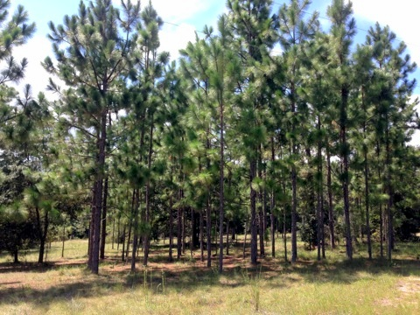
Sandhill Ecosystem
A Sandhill ecosystem is dry and dominated by pines and oaks.

Slide 5
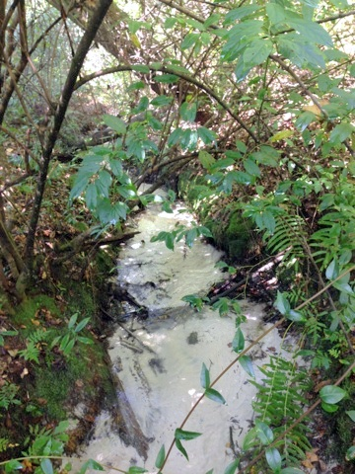
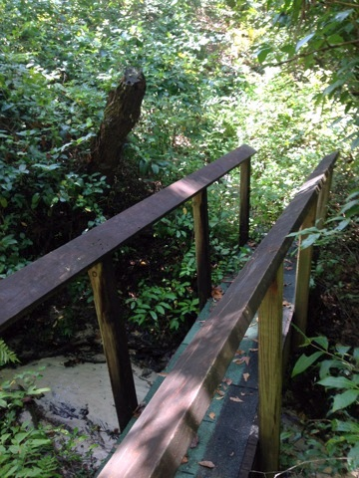
Hardwood Hammock Ecosystem
A Hardwood Hammock is moist and dominated by trees with broad leaves.

Slide 6
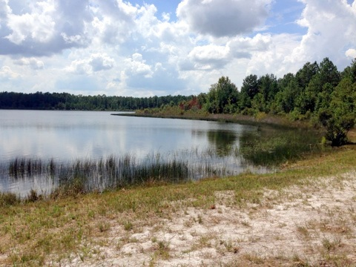
Freshwater Lake Ecosystem
A Freshwater Lake is an ecosystem that is a body of water that is inhabited by animals and plants adapted to living in and around water.

Slide 7
CCL Vocabulary
Ecosystem
Observation
Taxidermy
Habitat
Compare
Contrast
Adapted

